Slide 2
Keeping Your School Safe
Tips for Preventing Sexual Abuse

Slide 3
Topics
Who is Praesidium?
Scope of the Problem and Types of Abuse
Adult-to-Youth Abuse and Boundary Violations
Preventing False Allegations
Youth-to-Youth Abuse and Sexualized Behaviors
Managing Higher-Risk Situations
How to Respond

Slide 4
About Praesidium
“To help you protect those in your care from abuse and to help preserve trust in your organization.”
Two decades of experience
More than 4,000 clients across diverse industries
Completed thousands of root cause analyses
Developed proprietary abuse risk management model
Offer complete range of risk management solutions

Slide 5
We believe abuse is
PREVENTABLE

Slide 6
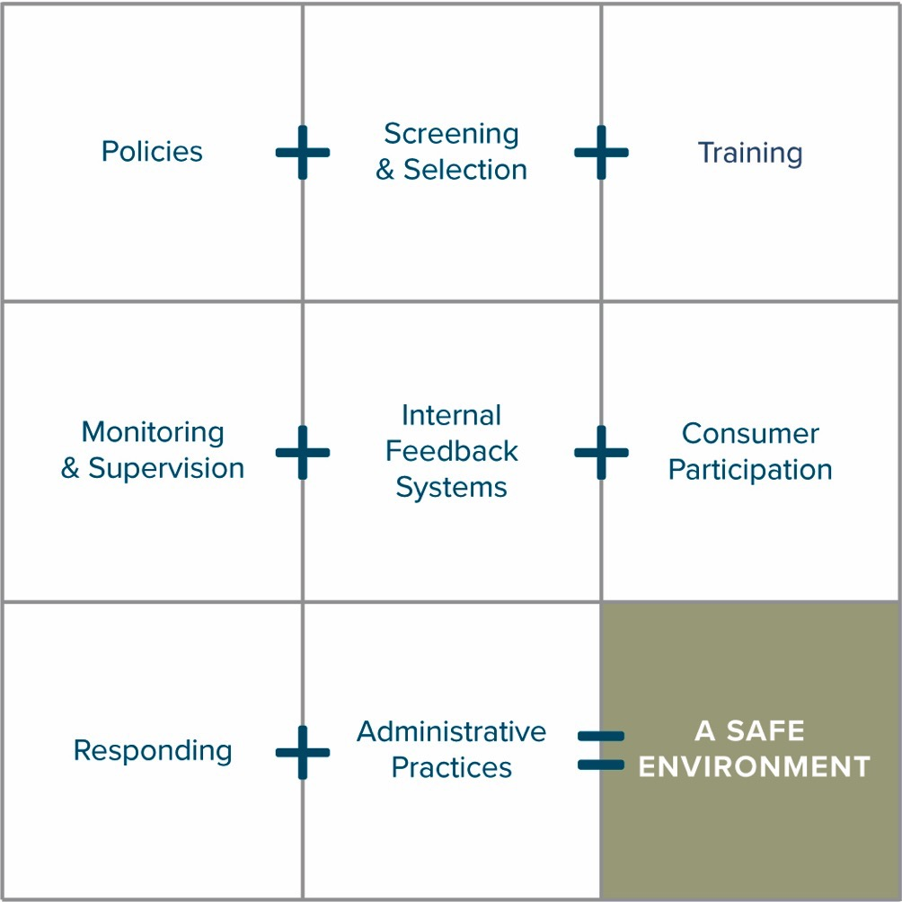
Praesidium
Safety
Equation®

Slide 7
Types of Sexual Abuse
Adult-to-Youth
Abuse
Youth-to-Youth
False Allegations
Notes:
When I say the word ‘abuse’ – what might that include?

Slide 8
Adult-to-Youth Abuse
and Boundary Violations
Notes:
But we want to begin with Adult to youth abuse. This section is where we are going to look at who offenders are and how they operate. We don’t present this information to you so that you can diagnose who is an offender and what type, but rather to demonstrate how abuse can take place.

Slide 9
Scope of the Problem
10%
50%
80%
One in four girls
One in seven boys
25%
Ten percent of school children
14%
Forty to fifty percent of child molestations committed by juveniles
Eighty percent of abuse does not get reported

Slide 10
Who is Most Likely to Abuse a Child?
Of all Sexual Abuse Cases that are perpetrated:
29% are by family members.
60% are by someone else the child knows.
11% are by strangers.
Are you surprised by these numbers? What did you expect?

Slide 11
How Adult-to-Youth Abuse and False Allegations Occur
Access
Control
Privacy
Access
Privacy
Control
Notes:
And lastly offenders need control. In order to gain that control, offenders must be patient and groom their victims.

Slide 12
Red Flag Behaviors
Prefers time and friendships with youth more than adults
Gives special gifts to youth, especially without permission
Engages in too much physical contact with youth
Bends the rules for certain youth
Ignores policies about interacting with youth
Has “favorite” or preferred youth
Uses inappropriate language or jokes
Behaves as a peer with youth rather than a supervising adult
Uses social networking sites and text messages to contact youth privately or away from programming
Finds reasons to spend time alone with youth
Notes:
So to continue that conversation, these are some of the behaviors that we frequently see in adult offenders. Just keep in mind that we are looking for clusters of these behaviors. Just because someone does 1 of these, does not mean they are an offender. We are looking for someone who is doing many of these behaviors. and doesn’t stop regardless of being called out on that behavior.

Slide 13
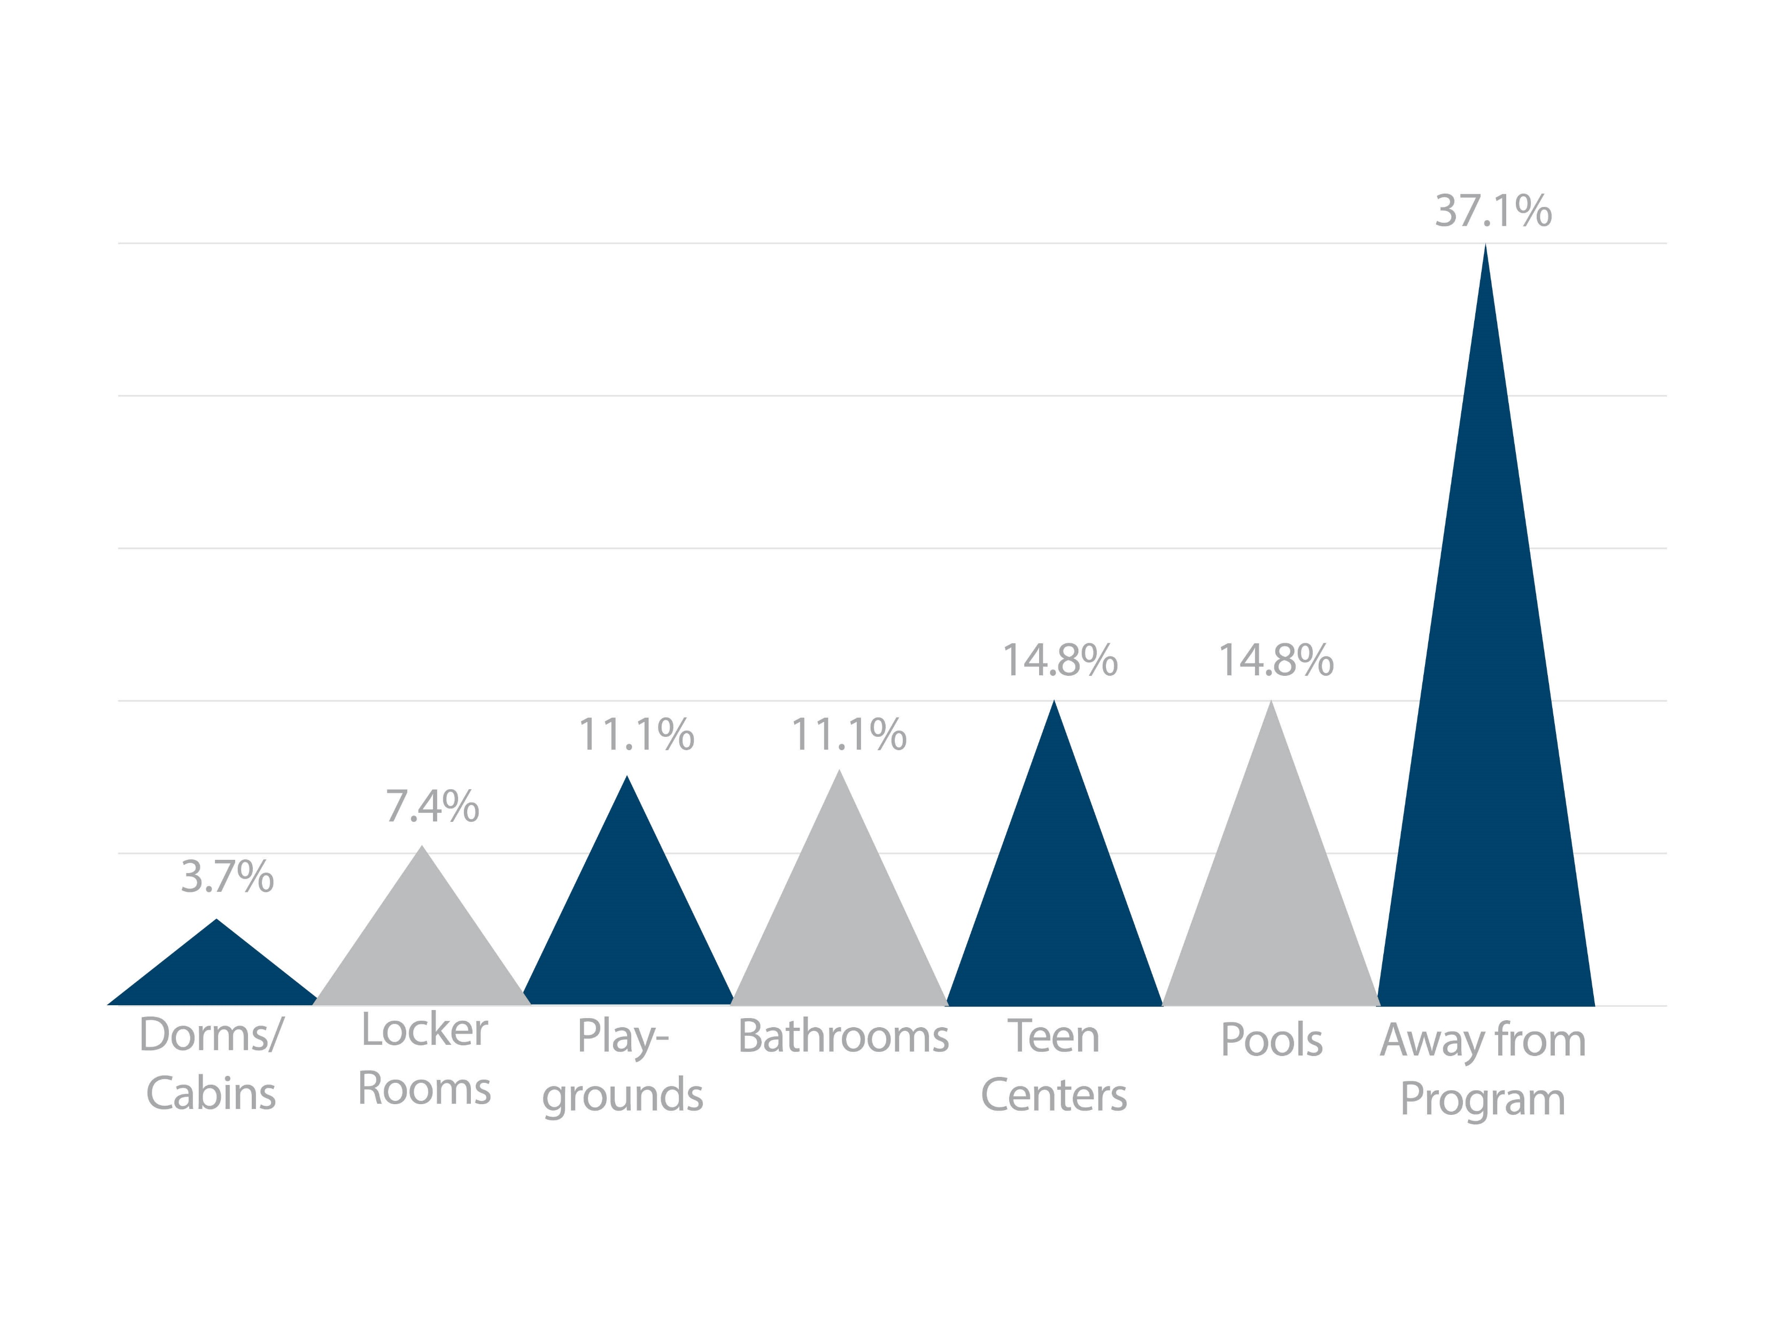
Praesidium Data Trends: Where Adult-to-Youth Sexual Misconduct Occurs
Download the Praesidium Report

Slide 14
Establishing Better Boundaries with Youth
Texting
Social Media
Emailing
Babysitting
Tutoring
After Hours Coaching or Lessons
Close Knit Community

Slide 15
Preventing False Allegations
Notes:
Switch gears and talk about false allegations. As we are talking about this, consider those warning signs and red-flag behaviors in connection with adult offenders. Avoiding these behaviors, or even the appearance of these behaviors, will be an important step in avoiding a false allegation.

Slide 16
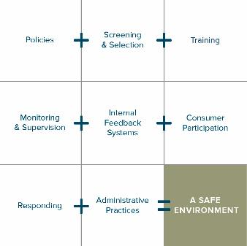
Decreasing Adult-to-Youth Abuse and False Allegation Risks
Following policies governing interactions with students
Reducing one-on-one interactions
Increased supervision
Training and increased awareness

Slide 17
Protecting Yourself from False Allegations
Use the rule of “three or more” and “line of sight”
Don’t show favoritism
Follow policies about appropriate and inappropriate interactions
Avoid, address, and respond to crushes
No secrets with students
Avoid gift-giving
Avoid non-group social media and electronic communications
Ask yourself: How would this appear to an outsider?
Notes:
Many individuals are rightfully worried about false allegations. They can ruin your career, your reputation, and cause you to never want to work with youth again. I want to point out though that only 3-8% of allegations of abuse made by youth are unfounded. With that being said, all allegations should be taken seriously and properly investigated. On this slide, you will see simple practical and effective ways to protect yourself from false allegations.
I want to give you a few seconds to review this list, if you haven’t already, and think about what Chris could’ve done in this scenario I’m about to read to you.

Slide 18
Youth-to-Youth Abuse and Sexualized Behaviors

Slide 19
Student-to-Student Abuse
17,000 reported incidents between fall 2011 and spring 2015
For each incident involving an adult, seven incidents of abuse by another student occur
Majority of incidents involve students 10 years or older
“Hidden horror of school sex assaults revealed,” Associated Press (May 2017)

Slide 20
How Youth-to-Youth Sexualized Behaviors and Abuse Occur
Opportunity
Location
Activity
Lack of Monitoring
Poor Planning
Sexual Curiosity
Sexual Abuse

Slide 21
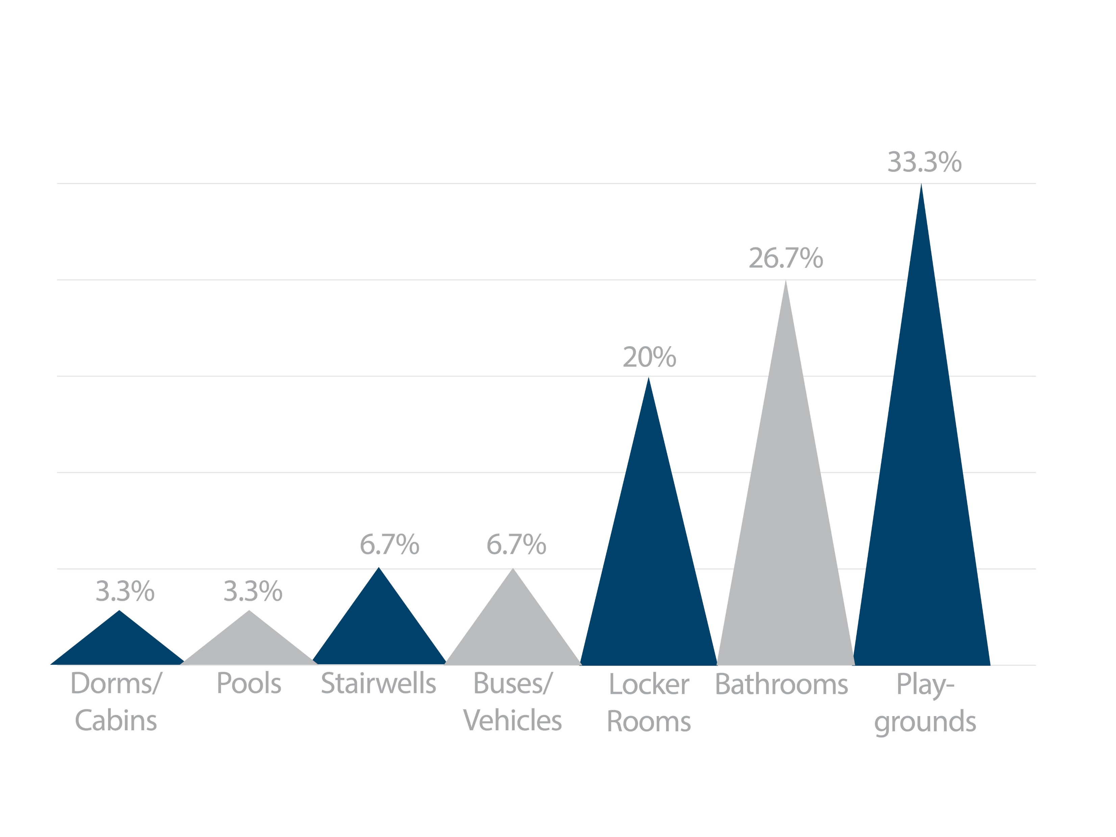
Praesidium Data Trends: Where Youth-to-Youth Sexualized Behaviors and Abuse Occur
Download the Praesidium Report

Slide 22
Decreasing Youth-to-Youth Abuse Risks
Structured activities at all times
Maintain approved ratios
Line-of-sight supervision
Follow guidelines for affection
Maintain “zero tolerance”
Document and report policy violations
Respond to incidents of youth-to-youth sexual activity

Slide 23
Managing Higher-Risk Situations

Slide 24
Higher-Risk Situations
Activity Risks
Architectural Risks
Undressing and nudity
Transportation
Periods of transition
Bathrooms and locker rooms
Mixed age groups
Youth supervising youth
Youth Truth or Dare and games involving power dynamics
Isolated areas, rooms
Rooms without windows or access to informal monitoring
Bathrooms and locker rooms
Outdoor/wilderness areas

Slide 25
Bathroom and Locker Room Tips
Make isolated areas strictly off-limits, except when monitored by adults.
Follow the Rule of Three.
When possible, take group bathroom breaks. Have an adult stand outside the doorway, within earshot.
When possible, limit the number of students in a bathroom to the number of stalls.
Prohibit horseplay.

Slide 26
Travel and Overnight Tips
Clarify the supervision roles
Design a supervision plan with particular attention paid to:
Free Time
Transitions
Common Areas
Bathrooms
Overnights
Delineate off-limits areas
Communicate all rules and expectations with program participants early on
Evaluate who has access to facility and program participants

Slide 27
How to Respond

Slide 28
Reporting and Responding
Inappropriate Behaviors
Suspicions of Abuse
Youth-to-Youth Sexual Behavior

Slide 29
Why Reporting is Crucial
Protects students and other victims
Protects employees, students, and volunteers
Protects the school and your program

Slide 30
Responding to Inappropriate
Behaviors or Policy Violations
Interrupt and spotlight the behavior
Report warning signs immediately to your supervisor or administrator
If the behavior does not stop, keep reporting your suspicions up the chain of command
Don’t wait until you witness an act of abuse – report suspicious behavior and policy violations
Notes:
I know it can be uncomfortable to report a policy violation or inappropriate behavior, especially if it’s a colleague. But we certainly do not want to sit back and wait to see if the situation gets any worse. We could be endangering the youth in this way. 9 times out of 10, you will not see an offender in the act of abuse. You also don’t know what others around you have seen.
Scale of 1-10, 10 being the most alarming

Slide 31
Responding to Suspicions
or Incidents of Abuse
Interrupt the behaviors if witnessed.
Follow mandated reporting requirements.
Report immediately to your supervisor or designated administrator.
Follow documentation requirements.

Slide 32
Responding to Youth-to-Youth
Sexual Behaviors
Respond immediately to inappropriate behaviors and notify your supervisor or administrator
You should not determine if the sexual behavior is abuse or “normal curiosity”
Document the behaviors
Keep reporting if the student continues to exhibit inappropriate behaviors

Slide 33
How to Respond if a Youth Discloses Abuse or Neglect
Stay Calm
Don’t Criticize
Report
Listen
Comfort
Note the Facts
Remember: It is never your responsibility to probe or investigate. Always report the allegation up to your supervisor.

Slide 34
Praesidium Resources
Armatus® Learn to Protect Training System
Web-based and Free!
Know Your Score! Online Self Assessment
Assess your church against best practice standards and receive customized resources. Free!
Background Checking Services
Discounted, and in many cases subsidized up to 50%.

Slide 35
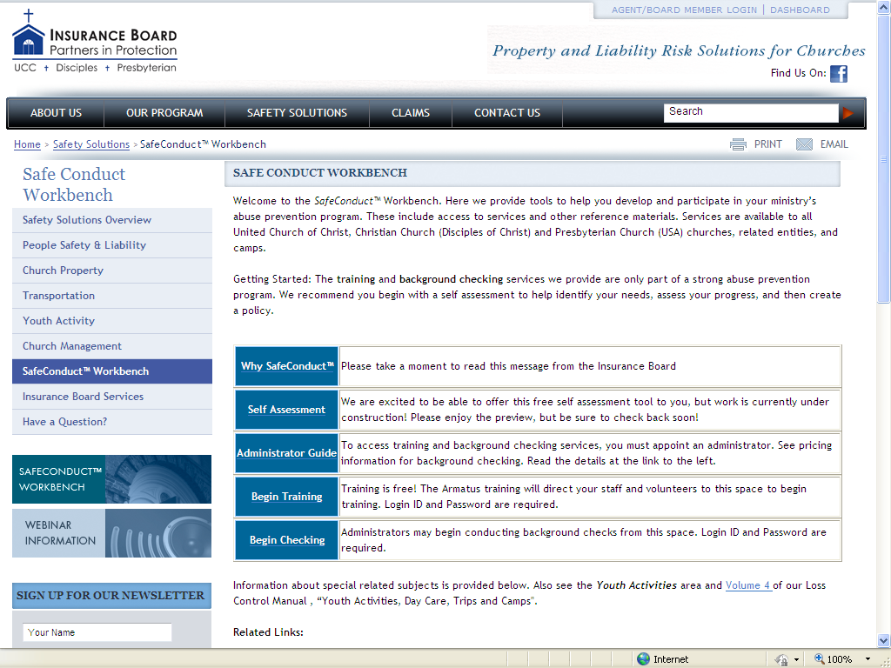
SafeConduct™ Workbench
www.InsuranceBoard.org

Slide 36
KEEP IN TOUCH
Christy Schiller, MA
VP, Account Services
CSchiller@PraesidiumInc.com
Praesidium 817.801.7773 www.PraesidiumInc.com

