Slide 1
Protective Security Advisor (PSA) Program
CISA Resources
Support For Your Organization

Slide 2
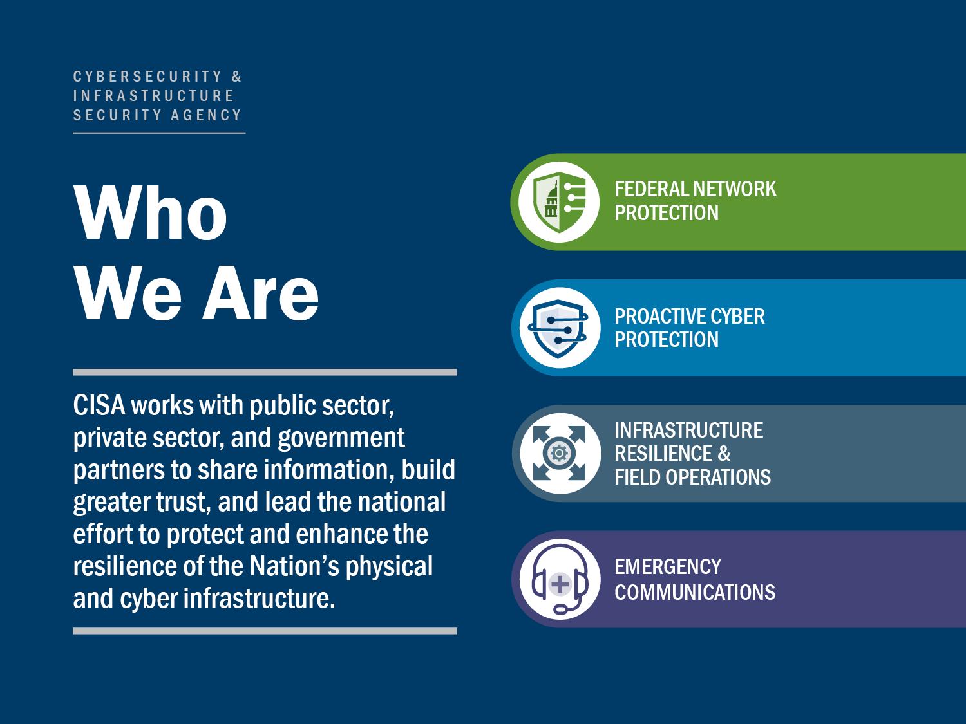

Slide 3
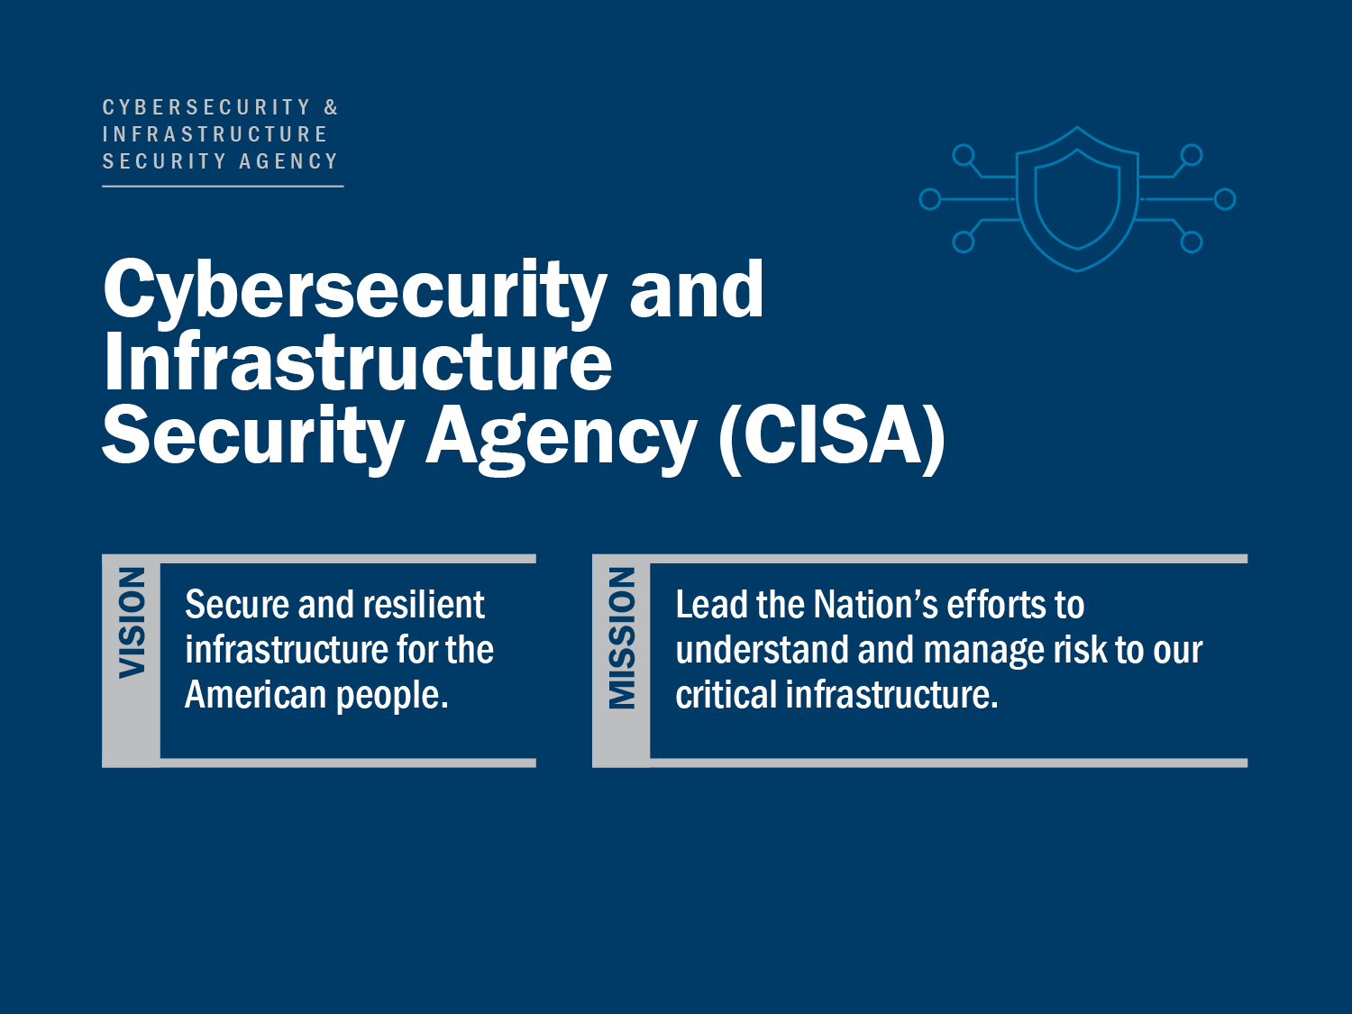

Slide 4
Protective Security Advisors
PSAs are field-deployed personnel who serve as critical infrastructure security and resilience specialists
State, local, tribal, and territorial (SLTT) and private sector link to DHS CISA security and protection resources
    Coordinate vulnerability assessments, training, and other DHS products and services
    Provide a vital link for information sharing in steady state and incident response
    Assist facility owners and operators with obtaining security clearances
During contingency events, PSAs support the response, recovery, and reconstitution efforts of the States by serving as pre-designated Infrastructure Liaisons (IL) and Deputy ILs at the Joint Field Offices

Slide 5





PSA Mission Areas
SURVEYS AND ASSESSMENTS
PSAs conduct voluntary, non-regulatory security surveys and assessments on critical infrastructure assets and facilities within their respective regions.
OUTREACH ACTIVITIES
PSAs conduct outreach activities with critical infrastructure owners and operators, community groups, and faith-based organizations in support of CISA priorities.
SPECIAL EVENT SUPPORT
PSAs support Federal, State, and local officials responsible for planning, leading, and coordinating NSSE and SEAR events.
INCIDENT RESPONSE
PSAs plan for and, when directed, deploy in response to natural or man-made incidents.
BOMBING PREVENTION AND AWARENESS
PSAs work in conjunction with CISA’s Office for Bombing Prevention by coordinating training and materials for partners to assist in deterring, detecting, preventing, protecting against, and responding to improvised explosive device threats.

Slide 6
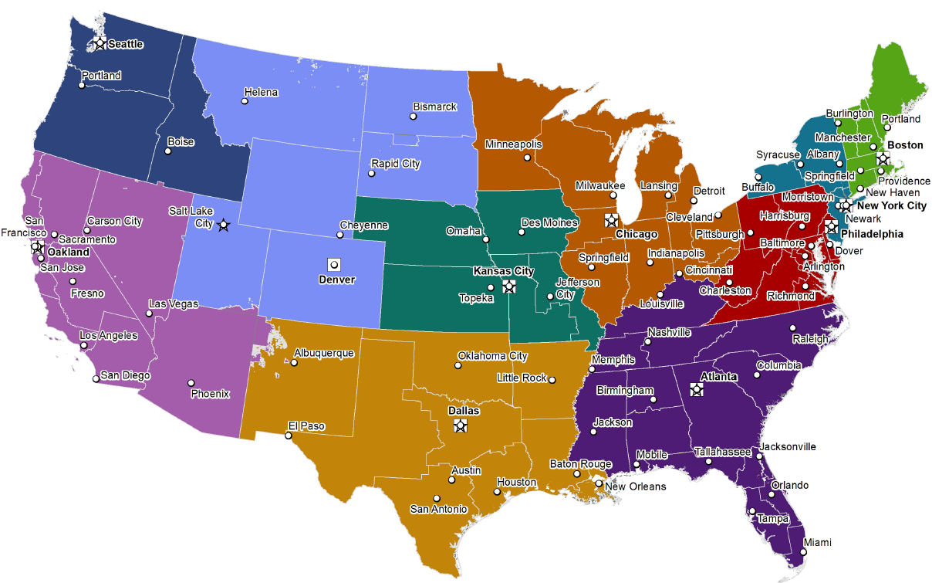
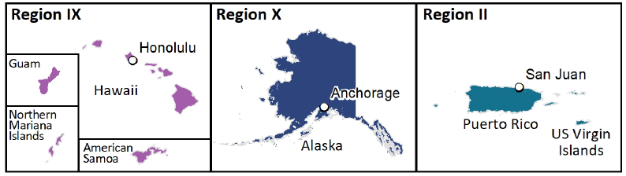
PSA Locations

Slide 7
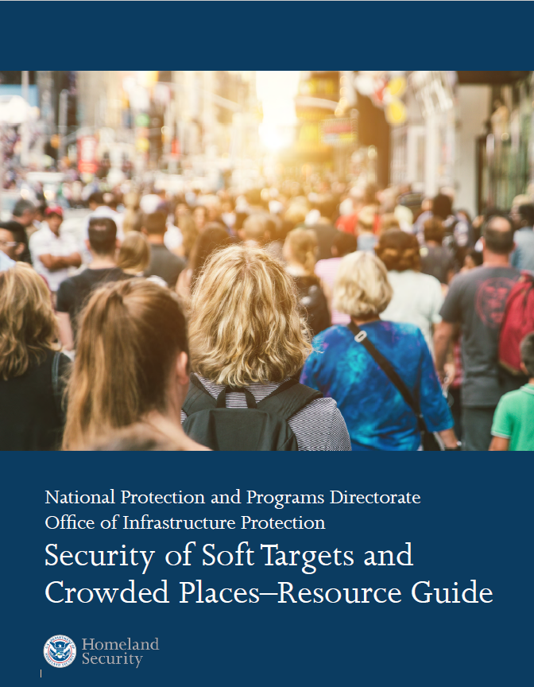
Security of Soft Targets & Crowded Places
Security of Soft Targets and Crowded Places – Resource Guide
The guide is a catalog of available CISA resources most relevant for soft targets and crowded places to help protect them
Offers a high-level overview of the different CISA resources and programs
Serves as a user-friendly launching point to websites, resources, and programs for more detailed information
Segments of our society are inherently open to the general public, and by nature of their purpose
do not incorporate strict security measures.

Slide 8
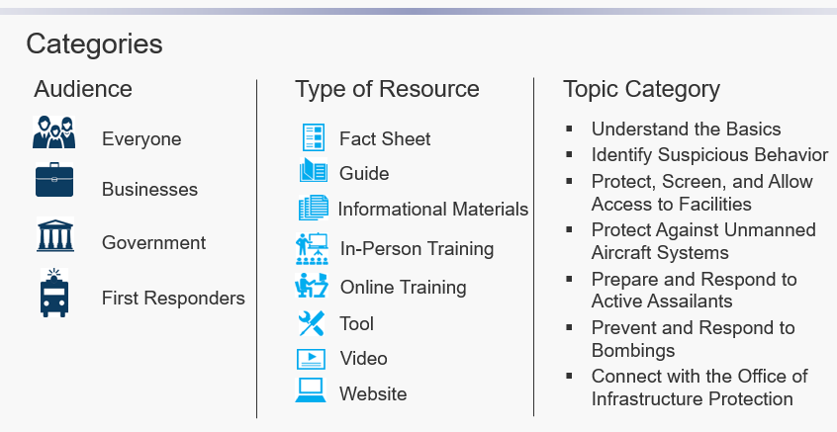
Security of Soft Targets & Crowded Places
Security of Soft Targets and Crowded Places – Resource Guide

Slide 9

CISA Assist Visits
Establishes and enhances DHS CISA’s relationship with your Houses of Worship, informs of the importance of your facilities, and reinforces the need for continued vigilance
During an Assist Visit, PSAs focus on coordination, outreach, training, and education
Assist Visits are often followed by security surveys using the Security Assessment at First Entry (SAFE) Tool, Infrastructure Survey Tool (IST), or delivery of other CISA services

Slide 10
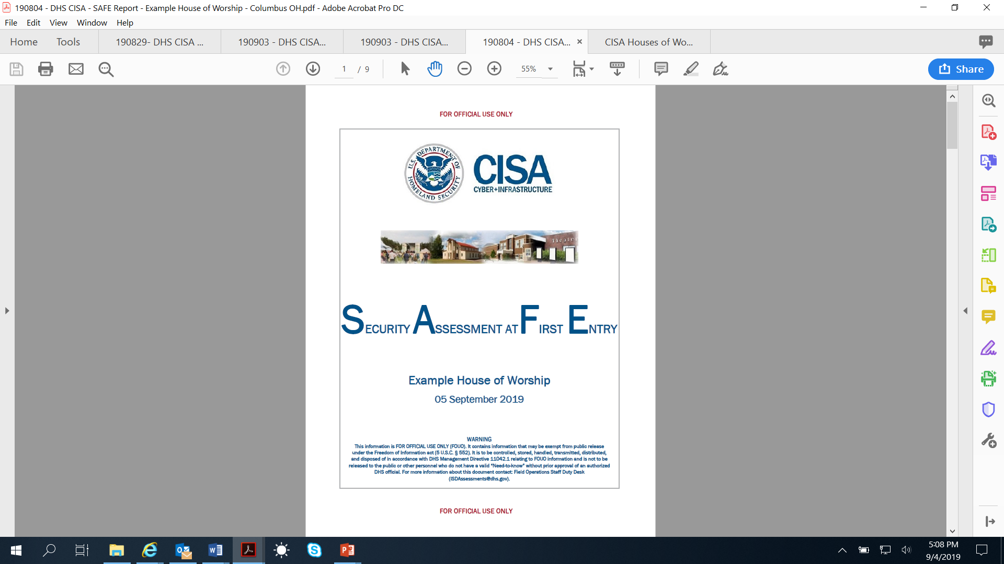
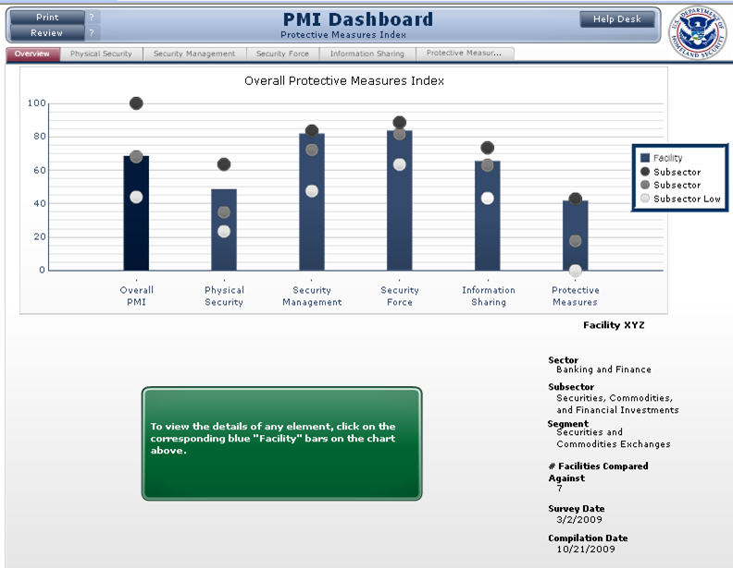
Security Assessments
CISA Security Assessments are available to your organizations leveraging:
  Security Assessment at First Entry (SAFE) Tool
  Infrastructure Survey Tool (IST)

Slide 11
SAFE Security Assessment
SAFE is designed to assess the current security posture and identify options for Houses of Worship to mitigate against relevant threats
  It is not intended to be an in-depth security assessment
SAFE may be the first step toward an effective security program
  In the future, it may be appropriate to conduct a more detailed assessment, particularly after additional security measures have been implemented

Slide 12
SAFE Security Assessment
This Tool generates a SAFE Report, following our visit
The SAFE Report lists:
  Commendable actions (what the facility is doing well);
  Vulnerabilities (what the facility could improve); and
  Options for consideration (potential security enhancements) based on the Protective Security Advisor's observations and discussions with key site personnel during that visit

Slide 13
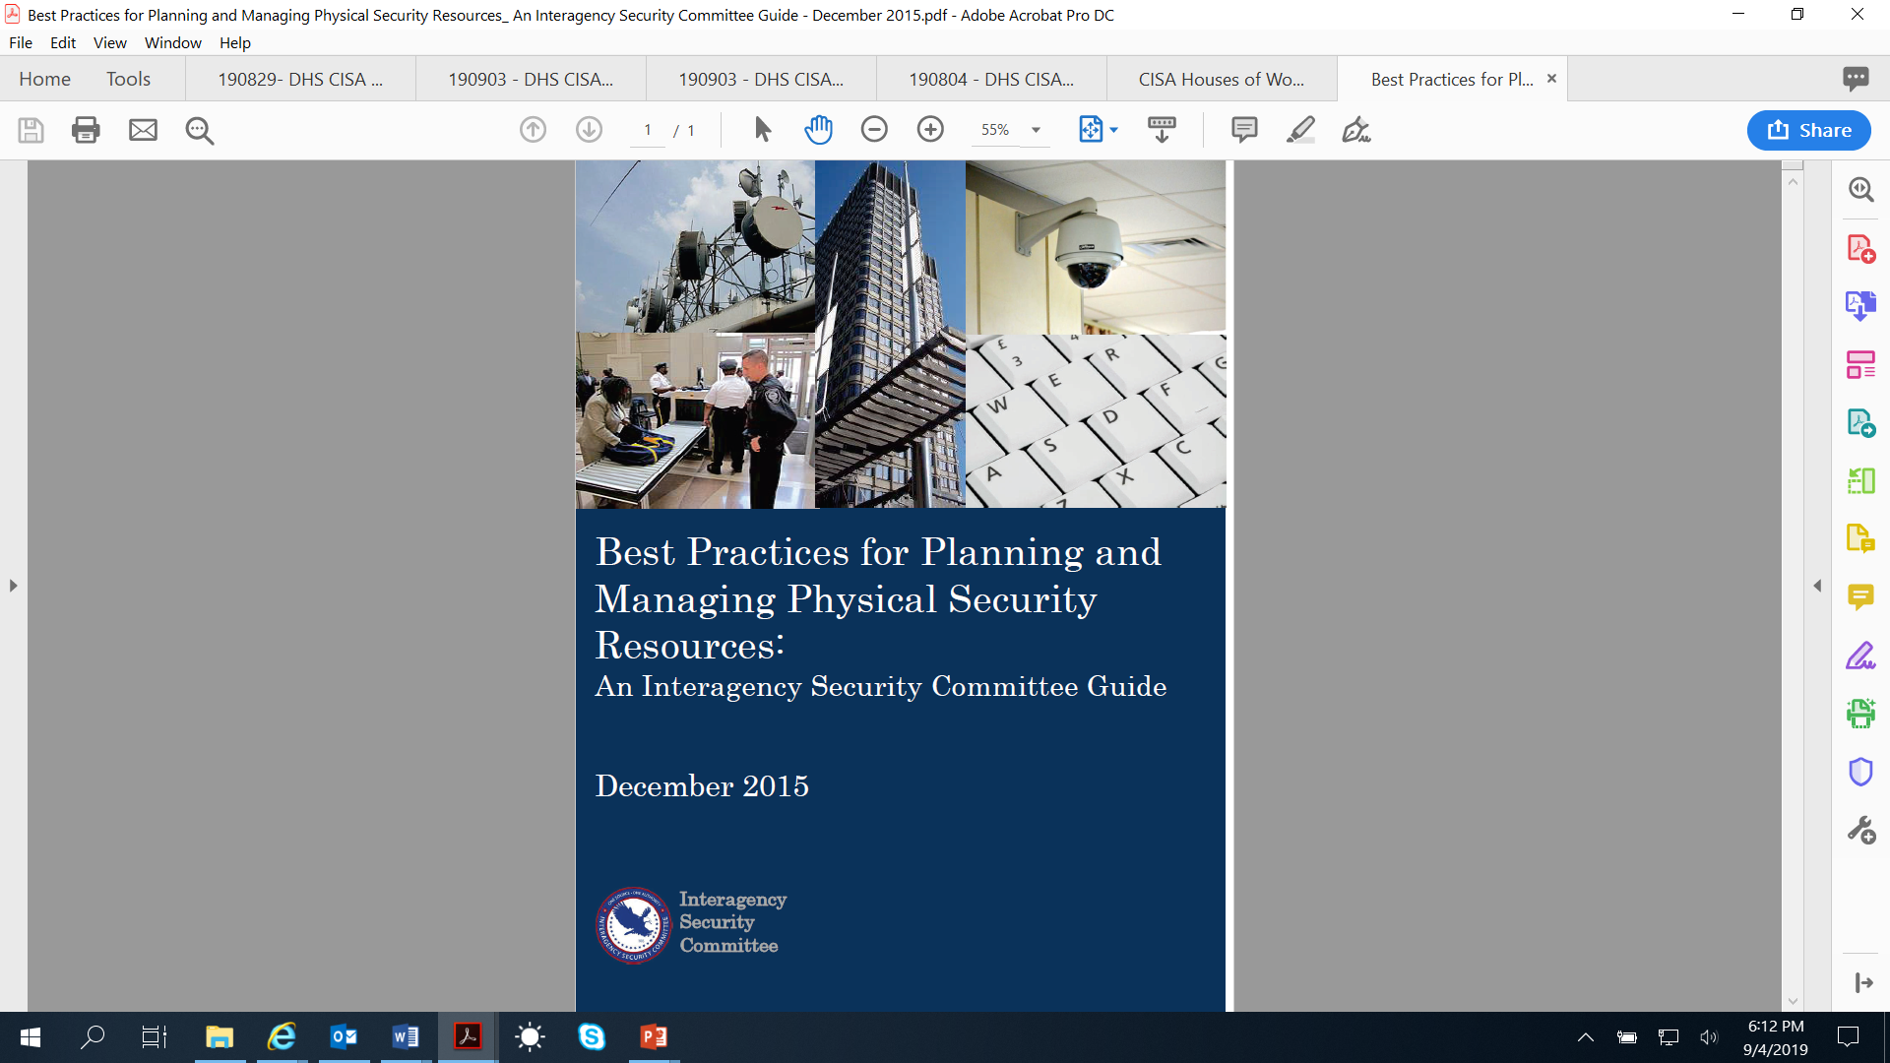
IST Assessment
The Infrastructure Survey Tool (IST) is a web-based vulnerability survey tool that applies weighted scores to identify infrastructure vulnerabilities and trends across sectors
Facilitates the consistent collection of security information
  Physical Security
  Security Force
  Security Management
  Information Sharing
  Protective Measures
  Dependencies

Slide 14
IST Assessment
  The IST Report generates a Protective Measures Index and Resilience Measurement Index
  The tool allows CISA and facility owners and operators to:
  Identify security gaps
  Compare a facility’s security in relation to similar facilities
  Track progress toward improving critical infrastructure security

Slide 15
Infrastructure Visualization Platform
Infrastructure Visualization Platform (IVP)
  A data collection and presentation medium that supports critical infrastructure security, special event planning, and response operations by leveraging assessment data and other relevant materials
  Integrates assessment data with immersive video, geospatial, and hypermedia data
  Assists facility owners and operators, local law enforcement, and emergency response personnel to prepare for, respond to, and manage critical infrastructure, National Special Security Events (NSSEs), high-level special events, and contingency operations

Slide 16
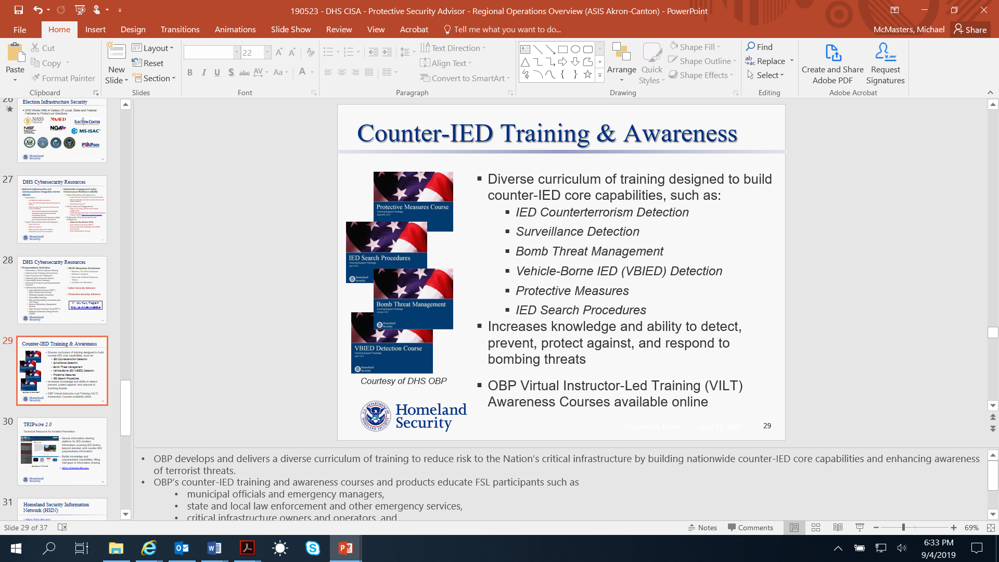
Counter-IED Training & Awareness

Slide 17
Exercise Support
CISA offers support to the planning, development, and execution of Exercises
  Options include: Seminars, Workshops, Table-Top’s, Functional and Full-Scale exercises
CISA Region V’s Training & Exercise Coordinator works with your organization (start to finish) to ensure a successful event

Slide 18

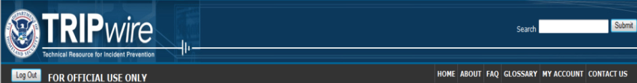
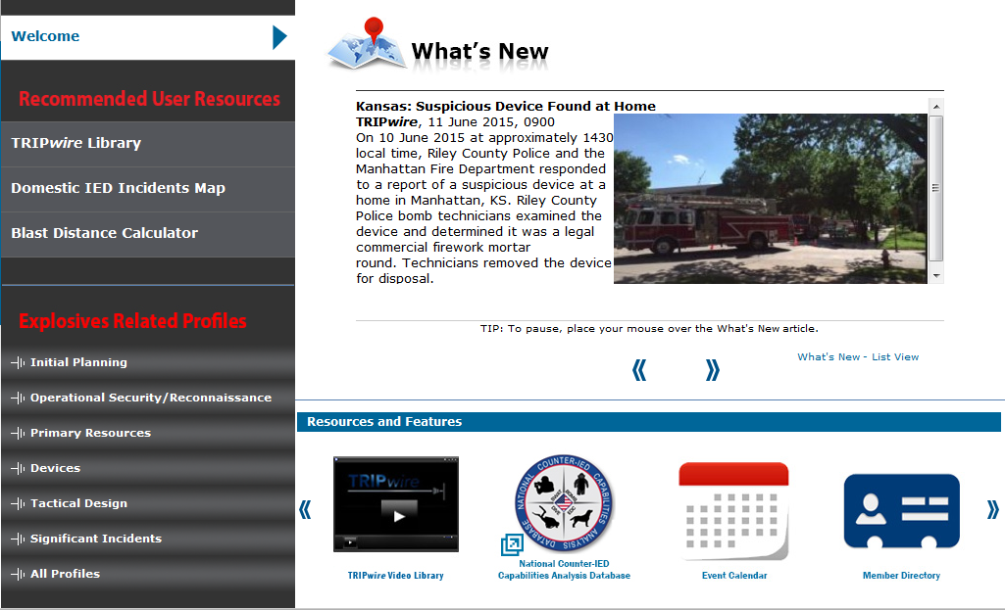
TRIPwire 2.0
Secure information sharing platform for IED incident information, evolving IED tactics, lessons learned, and counter-IED preparedness information
Builds knowledge and preparedness capabilities, filling vital gaps in information sharing
https://tripwire.dhs.gov

Slide 19

Homeland Security Information Network (HSIN)
https://hsin.dhs.gov/
HSIN is DHS’s primary technology tool for trusted information sharing
HSIN – Critical Infrastructure (HSIN-CI) enables direct communication between:
  DHS
  Federal, State, and local governments
  Critical infrastructure owners and operators

Slide 20
Homeland Secure Information Network (HSIN)
HSIN Content includes:
  Planning and Preparedness: Risk assessments, analysis, guidance, and security products; geospatial products and hurricane models; and exercise and national event info
  Incident Reporting and Updates: Real-time situational reports and alerts
  Situational Awareness: Daily and monthly sector-specific and cross-sector reports on topics ranging from cybersecurity to emerging threats
  Education and Training: Training on topics ranging from critical infrastructure resilience, to threat detection and reaction for retail staff

Slide 21
Cybersecurity Resources
Cyber Preparedness Activities
  Information / Threat Indicator Sharing
  Cybersecurity Training and Awareness
  Cyber Exercises and “Playbooks”
  National Cyber Awareness System
  Vulnerability Notes Database
  Information Products and Recommended Practices
  Cybersecurity Evaluations
    Cyber Resilience Reviews (CRR™)
    Cyber Infrastructure Surveys
    Phishing Campaign Assessment
    Vulnerability Scanning
    Risk and Vulnerability Assessments (aka “Pen” Tests)
    External Dependency Management Reviews
    Cyber Security Evaluation Tool (CSET™)
    Validated Architecture Design Review (VADR)
Cyber Response Assistance
  Remote / On-Site Assistance
  Malware Analysis
  Hunt and Incident Response Teams
  Incident Coordination
Cyber Security Advisors
Protective Security Advisors
CISA Integrated Operations Coordination Center (CIOCC)

Slide 22
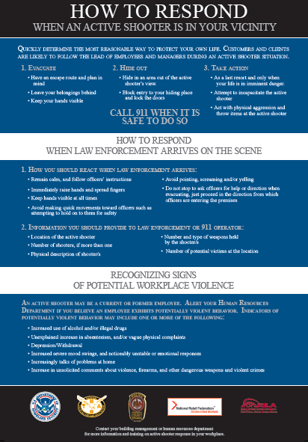
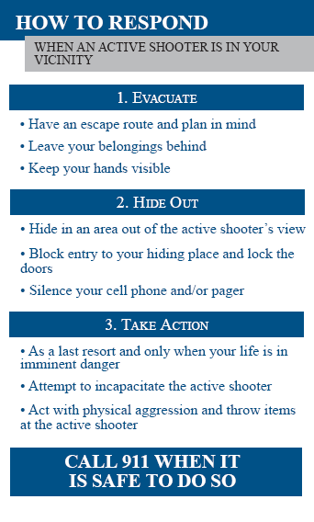
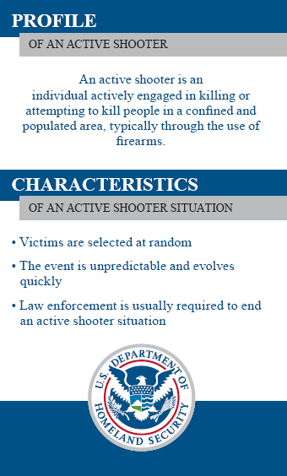
Active Shooter Resources
DHS materials consist of three products:
  Guide Books
  Pocket Emergency Measures Guides
  Break Room Poster
To download these materials visit:
  www.dhs.gov/activeshooter

Slide 23
Active Shooter – Online Training
DHS released “Active Shooter, What You Can Do” (IS-907), an online training course available through the Federal Emergency Management Agency Emergency Management Institute:
  http://training.fema.gov/EMIWeb/IS/IS907.asp
The self-paced course takes approximately 45 minutes to complete.
Upon completion, participants can take a short online "final exam" that is instantly scored. A certificate is provided to participants who finish the course and pass the final exam.

Slide 24
Active Shooter Preparedness
DHS is partnering with local host partners to conduct Active Shooter Preparedness Workshops aimed at fostering communication between facilities and their local emergency response teams to improve coordination during and response during an active shooter event.
These one-day, facilitated seminars will focus on emergency responder and facility coordination, interoperability capabilities, communications protocols, best practices, and integration of local assets.
For additional information, contact your local PSA

Slide 25
Active Shooter Preparedness (Run, Hide, Fight)
In an active shooter situation, you should quickly determine the most reasonable way to protect your own life. You should:
  Run: If there is an accessible escape path, attempt to evacuate the premises
  Hide : If evacuation is not possible, find a place to hide where the active shooter is less likely to find you
  Fight: As a last resort, and only when your life is in imminent danger, attempt to disrupt and/or incapacitate the active shooter
It is important for staff/congregants to be trained so that they can react if they are ever confronted with an active shooter situation
If you are in harm’s way, you will need to decide rapidly what the safest course of action is based on the scenario that is unfolding before you

Slide 26

“If You See Something, Say Something”
The following link takes you to the official webpage:
  https://www.dhs.gov/see-something-say-something
To become a campaign partner, send an email to seesay@hq.dhs.gov and include:
  The entity you represent
  Your name and contact information (phone, email)
  The city and state in which your entity is located

Slide 27

Ohio Homeland Security

Slide 28
Information Sharing – Keeping in Touch
Connect with the Fusion Centers
  Ohio STACC (Columbus): STACC@dps.ohio.gov
  NEORFC (Cleveland): info@neorfc.us
  Greater Cincinnati Fusion Center (Cincinnati): GCFC@gcfc.org
Partner with Local Law Enforcement
  Invite local authorities to visit your facility
Engage with your Peers
  Work together, share ideas. Consider joining the Faith-Based Information Sharing and Analysis Organization (FB-ISAO)

Slide 29
For more information:
cisa.gov
Contact Us:
Michael McMasters
Protective Security Advisor
michael.mcmasters@hq.dhs.gov
216-318-1495 c
If you see
something,
say something

